Slide 1
Cse 416
Back-End APIs

Slide 2
What’s a Back-End API?
Provides CRUD access to Data
Access to what?
multiple applications
What does it need?
Database (Mongo DB)
ODM (Mongoose)
Query Language (GraphQL)
Server ? (Express)

Slide 3
Important References
How to create your first MERN (MongoDB, Express JS, React JS and Node JS) Stack by Sam Barros
My First MERN Application Repository
Mozilla Developer Network: Express web framework (Node.js/JavaScript)

Slide 4
Back-End API
Provides data services
query the database
mutate the database
Layered approach
database server
object data mapping
web server with request mapping

Slide 5
Technologies we’ll look at briefly
MongoDB
mongod
MongoDB Compass
Mongoose API
ExpressJS
Postman

Slide 6
What is an endpoint?
A remote computing device that communicates back and forth with a network to which it is connected. Examples of endpoints include:
Desktops
Laptops
Smartphones
Tablets
Servers
Workstations
Internet-of-things (IoT) devices

Slide 7
Basic Routing
Determining how an application responds to a client request to a particular endpoint
Each route can have one or more handler functions
Route definition takes the following structure:
app.METHOD(PATH, HANDLER)
app is an instance of express.
METHOD is an HTTP request method, in lowercase.
PATH is a path on the server.
HANDLER is the function executed when the route is matched.

Slide 8
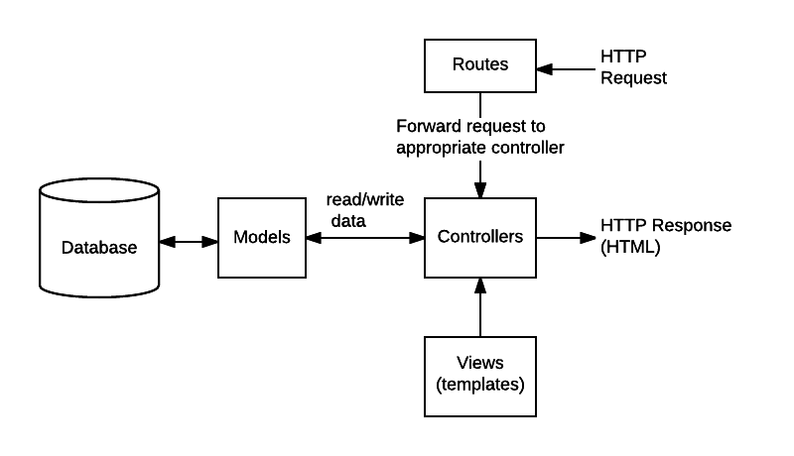
An approximate architecture

Slide 9
Requests and Responses contain payloads
i.e. the data
Both sides (client and server) need to know what the payload is
types
format
Client needs to know what is needed by server to do its work
Server needs to get the necessary payload data to complete its task
Example payloads:
data for creating a new movie

Slide 10
Middleware
Express use
Middleware function is executed every time the server receives a request

Slide 11
So what do we have to do?
Define our server
Setup our database connection
Specify our database schemas/models
Define our database queries and mutations
Specify router handlers, routing responses to queries and mutations
Test the routes and their corresponding queries and mutations

Slide 12
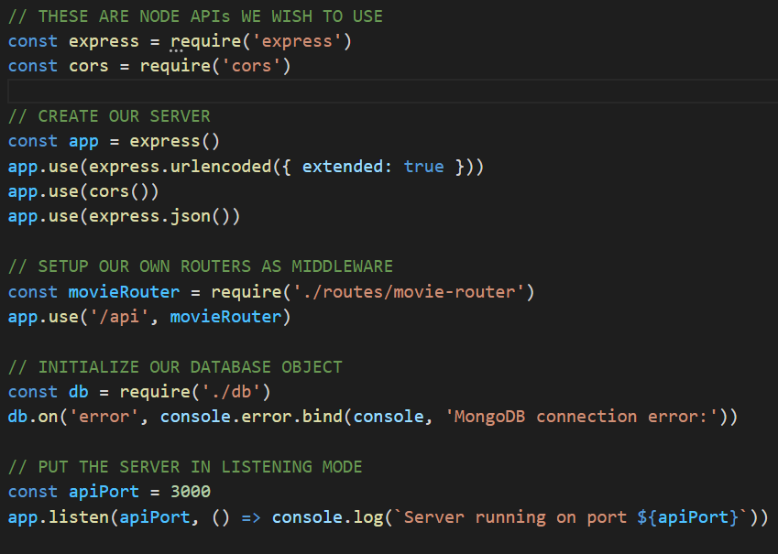
Setup our Server

Slide 13
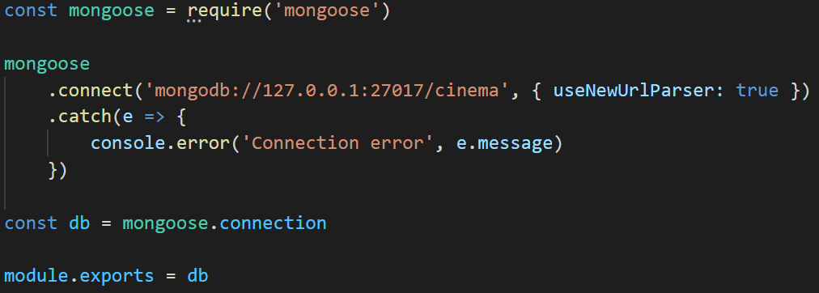
Setup our database connection

Slide 14
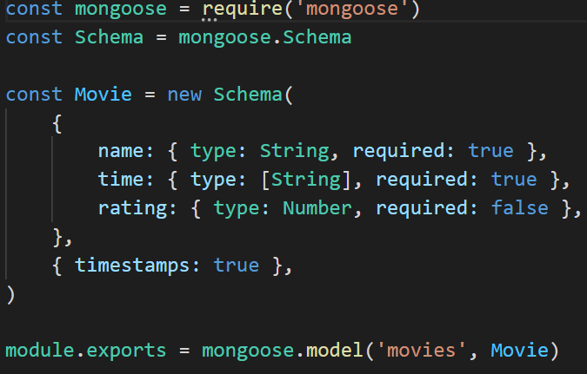
First Let’s Specify the Data Format

Slide 15
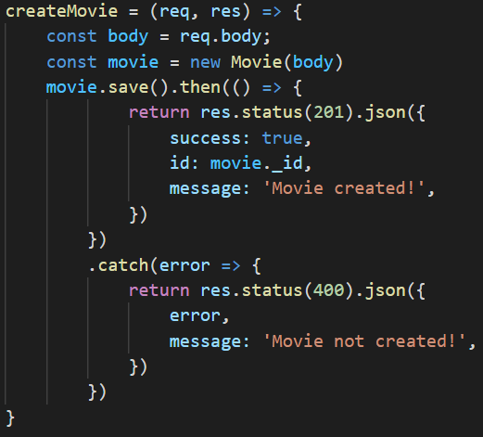
Define a mutation to create a movie

Slide 16
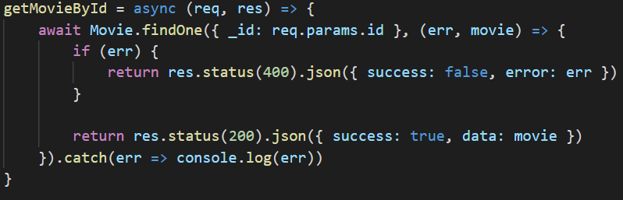
Define a query to get a movie using it’s unique id

Slide 17
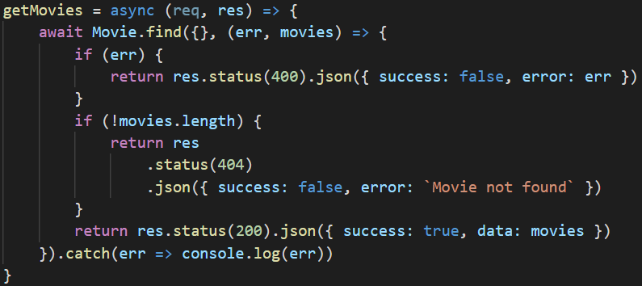
Define a query to get all the movies

Slide 18
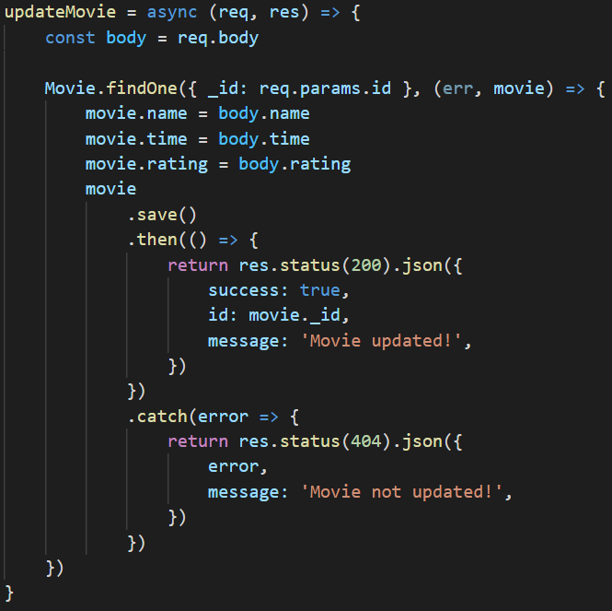
Define a mutation to update a movie by id

Slide 19
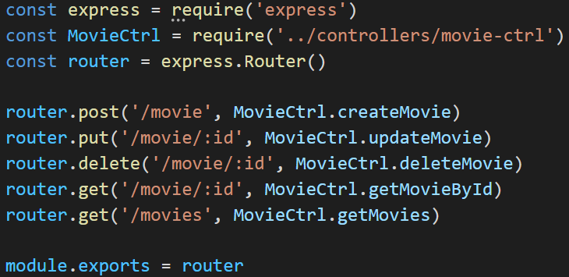
Specify all our Back-End API Routes

Slide 20
And that’s it
We’ve just made a back end API

Slide 21
Now let’s test it
Let’s create 5 Cinema Tests:
Add Movie
Update Movie
Get Movies
Get Movie
Delete Movie

Slide 22
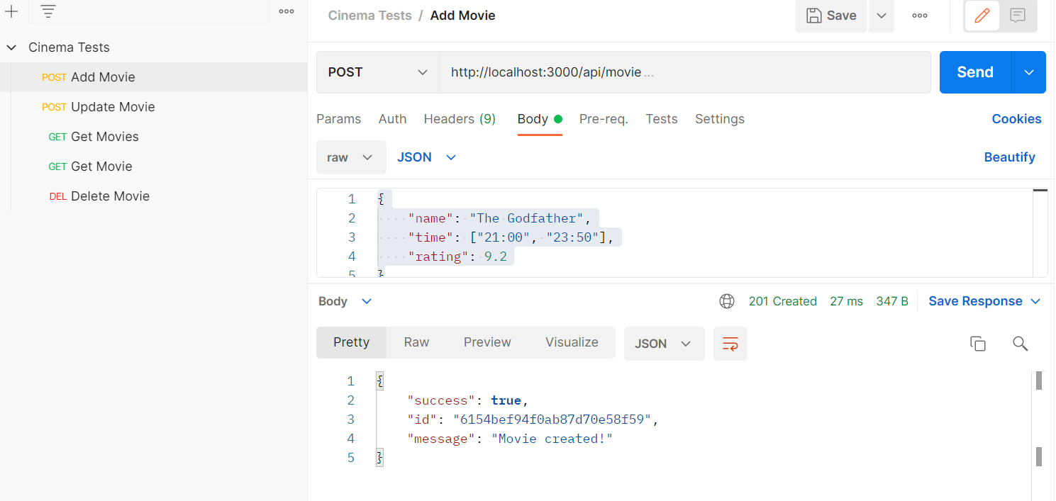

Slide 23
Task for Today
Determine all of your data needs
start modeling your back-end API

